Slide 1
Presentation on Super Resolution Image Generation using SRGAN
Course Tittle : Digital Image Processing Lab
Course Code : CSE - 5211

Slide 2
Submitted To
Md Mynoddin
Assistant Professor Rangamati Science & Technology University
Submitted By
Group Name: Analytics
Nur Mohammad
ID:2017-14-35
Emu Barua
ID: 2017-14-37

Slide 3
Table of Contents
01
02
04
Limitation
Introduction
07
Problem Overview
02
Future Work
08
Project Goal
03
Conclusion
09
Methodology
04
Experimental Result
05
Discussion
06

Slide 4
Introduction
In today's digital era, high-resolution images are indispensable across various applications such as medical imaging, surveillance, and digital entertainment. However, challenges like high computational costs and storage requirements hinder their accessibility. Super Resolution (SR) techniques offer a solution by enhancing low-resolution images while preserving vital visual details. SRGAN, a state-of-the-art deep learning approach, utilizes Generative Adversarial Networks (GANs) to produce realistic high-resolution images from low-resolution inputs. Throughout this presentation, we'll delve into SRGAN's principles, architecture, training process, and diverse applications, highlighting its effectiveness in overcoming the challenges associated with super-resolution tasks.

Slide 5
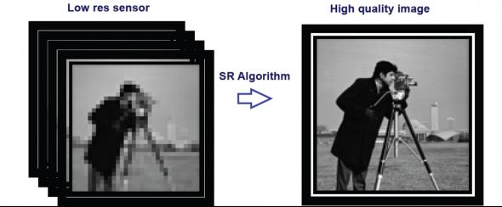
Problem Overview
Challenging problem → difficult to infer the values for multiple pixels from a single pixel
Significant advances in the last two years due to deep learning methods
First deep learning systems used ConvNets, recent state-of-the-art uses GANs
Goal is to find some mapping f(I^{LR}) = I^{SR} where I^{SR} is as close as possible to I^{HR}

Slide 6
Project Goal
Develop and implement a system for Super Resolution Image Generation using SRGAN.
Generate high-quality, realistic high-resolution images from low-resolution inputs.
Address limitations of traditional super-resolution techniques through deep learning and adversarial training.
Achieve state-of-the-art performance in super-resolution tasks across diverse domains.
Provide an efficient solution for enhancing image resolution while preserving vital visual details.

Slide 7
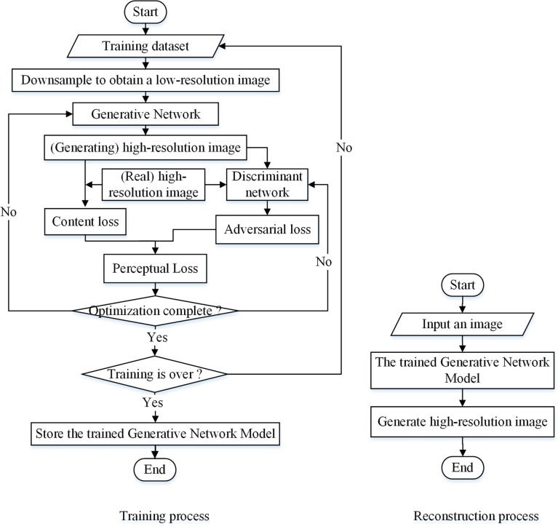
Methodology

Slide 8
Experimental Setup
Hardware Configuration
processor : AMD Ryzen 5 3400G
Physical RAM : 12GB RAM
GPU: 2GB Dedicated and 7GB Shared
Software and Tools Setup
Installed Python and required libraries such as scikit-learn, TensorFlow, and PyTorch.
Utilize Jupyter for writing and executing Python code.

Slide 9
Data Collection
In our project, we used a image dataset from Kaggle by Matteo Castrignano
The dataset can be found here: [https://www.kaggle.com/datasets/matteocastrignano/mirflickr].

Slide 10
Dataset
Size: The dataset contains 25000 images. During our work we use just 2000 random images for simplicity due to limitation of Hardware resource.
Features: The dataset includes a variety of type of image including clouds, sea, lake, river, night, tree, flower, dog, bird, car, people, baby, female, male, portrait

Slide 11
Data Preprocessing
During the project we use two type of Image Low Resolution and High Resolution. We convert our original Image to two different size and save into two different folder.
We consider
32x32 format as Low Resolution and
128x128 format as High Resolution

Slide 12
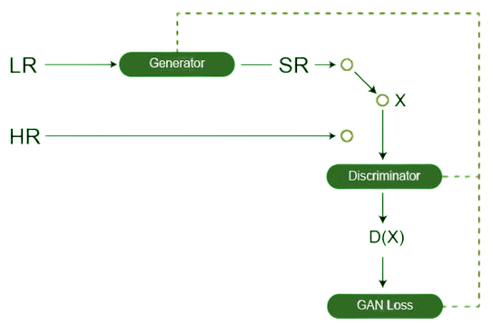
SRGAN Architecture
Fig: SRGANArchitecture

Slide 13
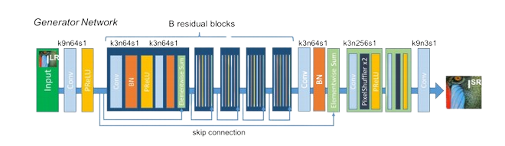
Generator Architecture
The generator architecture contains residual network instead of deep convolution networks because residual networks are easy to train and allows them to be substantially deeper in order to generate better results. This is because the residual network used a type of connections called skip connections

Slide 14
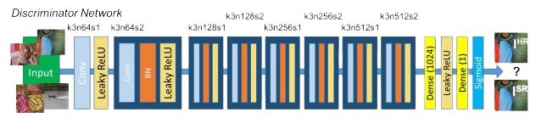
Discriminator Architecture
The task of the discriminator is to discriminate between real HR images and generated SR images. The network contains eight convolutional layers with of 3×3 filter kernels, increasing by a factor of 2 from 64 to 512 kernels. Strided convolutions are used to reduce the image resolution each time the number of features is doubled. The resulting 512 feature maps are followed by two dense layers and a leakyReLU applied between and a final sigmoid activation function to obtain a probability for sample classification.

Slide 15
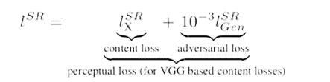
Loss Function
Perceptual loss is the combination of both adversarial loss(discriminator loss) and content loss(generator loss).

Slide 16

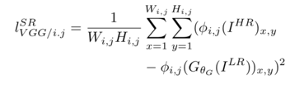
Content Loss
1. MSE loss: Pixel-wise error between high resolution image and super resolved image (generated image) is given as below:
2.VGG loss: φ(i,j) indicates the feature map obtained by the j-th convolution (after activation) before the i-th maxpooling layer within the VGG19 network. VGG loss is defined as the euclidean distance between the feature representations of a reconstructed image and the reference image:

Slide 17
Continue……….
To train the discriminator, the loss function uses the typical GAN discriminator loss.

Slide 18
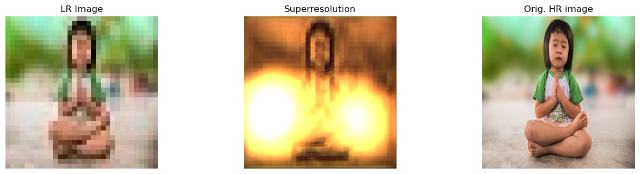
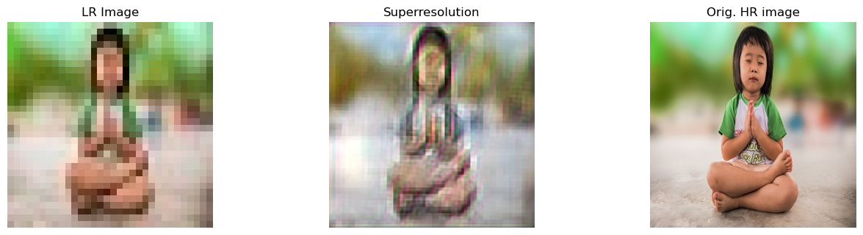
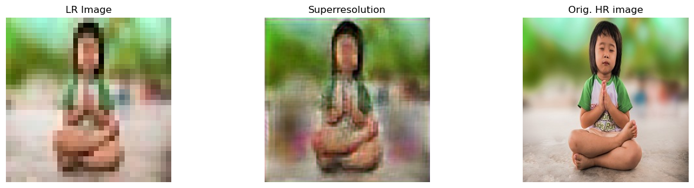
Output
5 Epoch
50 Epoch
150 Epoch

Slide 19
Limitation
Despite its effectiveness, SRGAN also has its limitations:
Computational Complexity
Model Size
Overfitting
Artifact Generation
Subjective Evaluation

Slide 20
Future Work
Future work in the realm of super-resolution image generation using SRGAN could focus on several avenues for advancement:
Efficiency Improvements
Scale Adaptation
Domain Adaptation
Attention Mechanisms
Uncertainty Estimation
Interpretability
Real-time Applications

Slide 21
Conclusion
In conclusion, our project demonstrates the effectiveness of SRGAN in addressing the challenge of low-resolution image quality. Through extensive experimentation and evaluation, we have showcased the remarkable capabilities of this state-of-the-art deep learning model in generating high-quality, super-resolved images. By preserving and enhancing important details, SRGAN surpasses traditional upscaling methods, offering superior visual fidelity and enabling enhanced image analysis, recognition, and visualization. Our research underscores the potential of SRGAN in revolutionizing image resolution enhancement techniques across diverse fields, paving the way for more accurate and impactful applications in areas such as medical imaging, satellite imagery, and digital photography.

Slide 22
Reference
[1] Tensorlayer. (n.d.). GitHub - tensorlayer/SRGAN: Photo-Realistic Single Image Super-Resolution Using a Generative Adversarial Network. GitHub. https://github.com/tensorlayer/SRGAN
[2] A super resolution algorithm based on attention mechanism and SRGAN network. (2021). IEEE Journals & Magazine | IEEE Xplore. https://ieeexplore.ieee.org/abstract/document/9496642
[3] https://www.geeksforgeeks.org/super-resolution-gan-srgan/

Slide 23
Thanks!

